Slide 1
Obtaining Donors for ASD
By: Megan Henderson, Anna Dye,
Nora Davis, and Anna Kormis

Slide 2
Persuasion Information

Slide 3
Central Processing
Elaboration Likelihood Model
Central Processing
Give options

Slide 4
Gravitas
Gravitas: seriousness
Print important letters on a heavier bond of paper

Slide 5
Have a Goal
Give donors a clear goal to aim for
Something to put their money towards
Show progress in the newsletter

Slide 6
Warmth Appeals
Personalized letters
Handwriting addresses or hand signing letters

Slide 7
Warmth Appeals Cont.
Holiday office photo

Slide 8
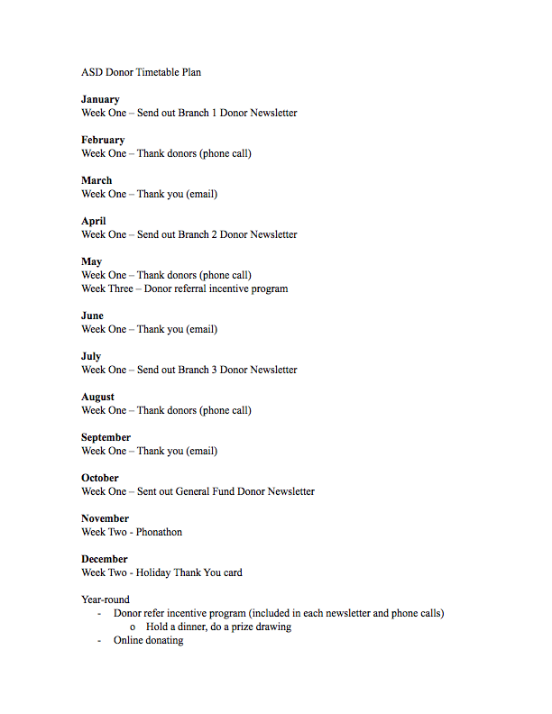
Timetable

Slide 9
Newsletters
Separated into three branches and special donor letter
Donor letter has different subheads but holds the same persuasive effect

Slide 10
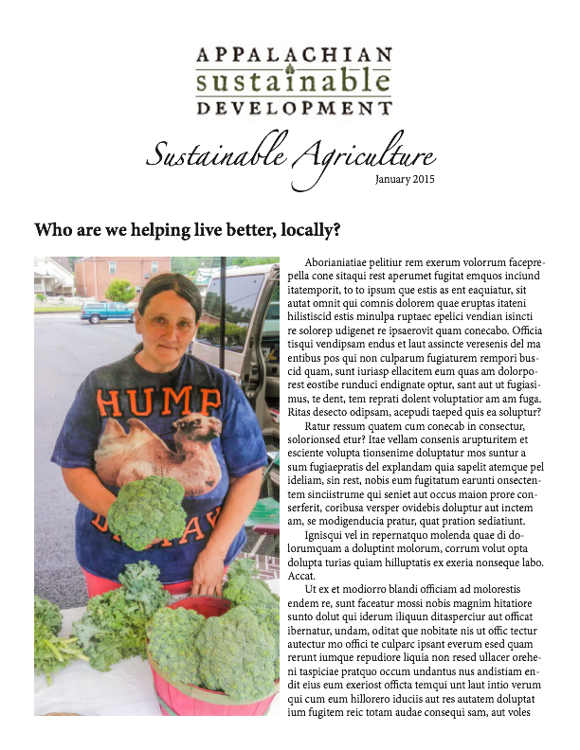
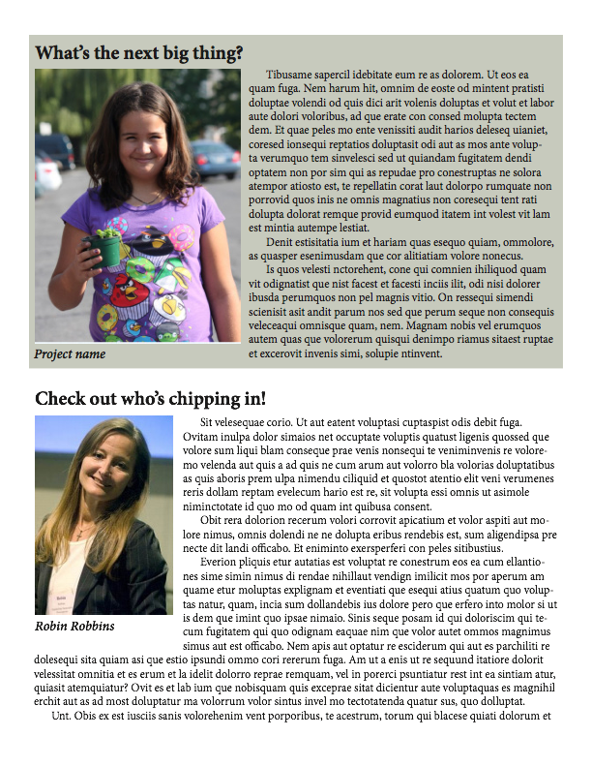
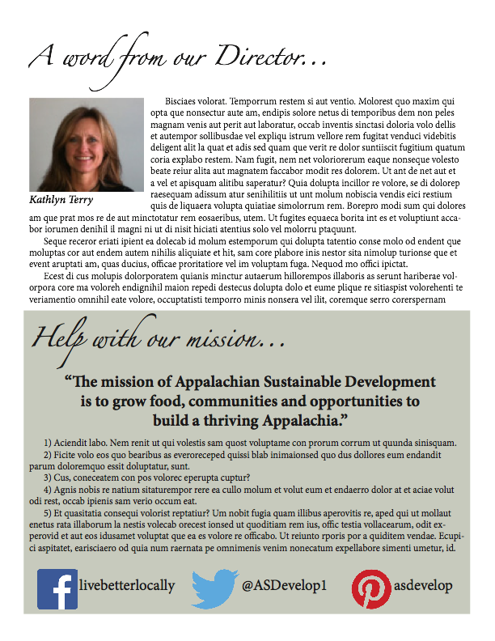
Branch Newsletter

Slide 11
Donor Newsletter

Slide 12
Thank You’s
Thanking donors is important!
Four different letters
Holiday Card
How it Works:
Give reason to donate
Smaller Projects
Reaching Demographics

Slide 13
Online Donating
Change the button!
Primary Information page before PayPal
Contact, where you’re giving, how much, etc.
Creating and naming a General Fund

Slide 14
Phone-a-thon
Personal contact has many advantages
Donor database
Volunteer Guide
including rules, script, and pointers
All callers in one room

Slide 15
Donor Incentive and Referral Program
Practiced throughout the year in phone calls, emails, social media, and newsletters
Can hold a picnic for donors who donate a certain amount of money
Can offer prizes such as pens, pins, t-shirts, or stickers for referring a new donor

Slide 16
Questions?

